Slide 1
Why Python or a Brief History of Computer Languages.

Slide 7
Check out the Still (light blue) bullets
These Still colored (light blue) bullets replace the Highlight bullets
These bullets now pass the accessibility requirements per our Brand Guidelines

Slide 8
This slide no longer contains our highlight color
This color has been changed to still (light blue)
These Still colored (light blue) bullets replace the Highlight bullets
These bullets now pass the accessibility requirements per our Brand Guidelines

Slide 12

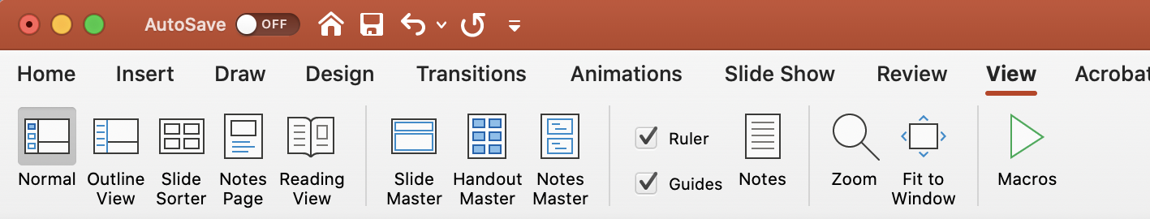
Margins and footers
Ensure footers are relevant and consistent. Always include a footer.
Stay within the margins. Find the margins in the View menu and click on Guides.

Slide 13
Example of graphs

Slide 14
Example of graphs

Slide 15
Example of chart
Head
Section A
Section B
Section C
1
2
3
1
2
3
1
2
3

Slide 16






























Popular icons — view full library for more
360°
Consolidate
Award
Barcode
Brain
Briefcase
Governance
Data
Delivery
Digital Transformation
New Document
Employee
Personalization
Gear
Handshake
Analyze
Hierarchy
Location
Messages
Customer
Dashboard
Server
Retail
Shopping Cart
Handcart
Arrows
Tag
Bullseye
Thumbs Up
Warehouse

Slide 17












Product icons — view full library for more

Slide 18
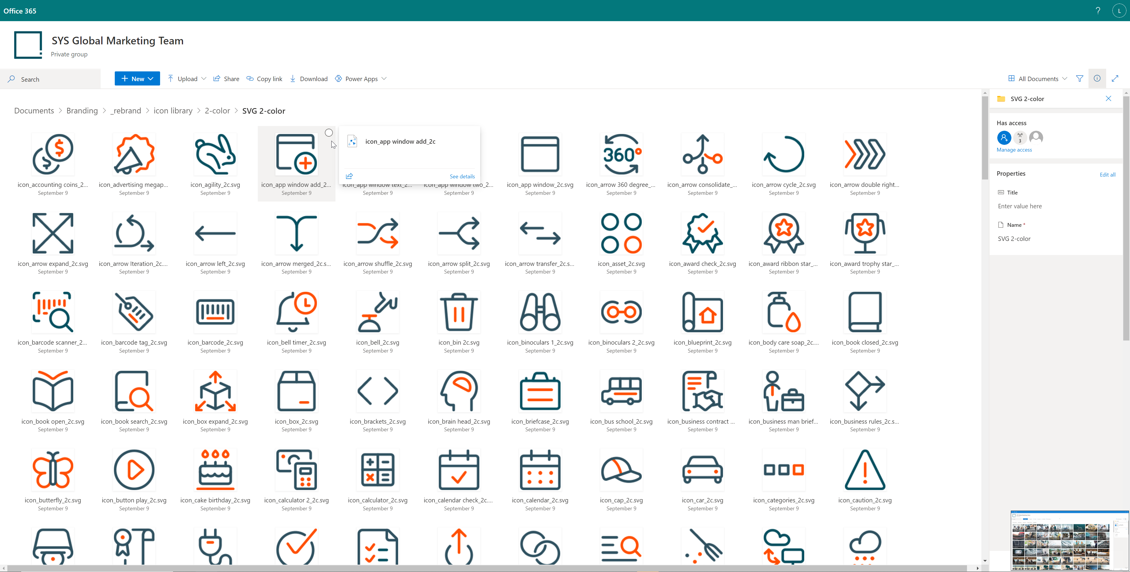
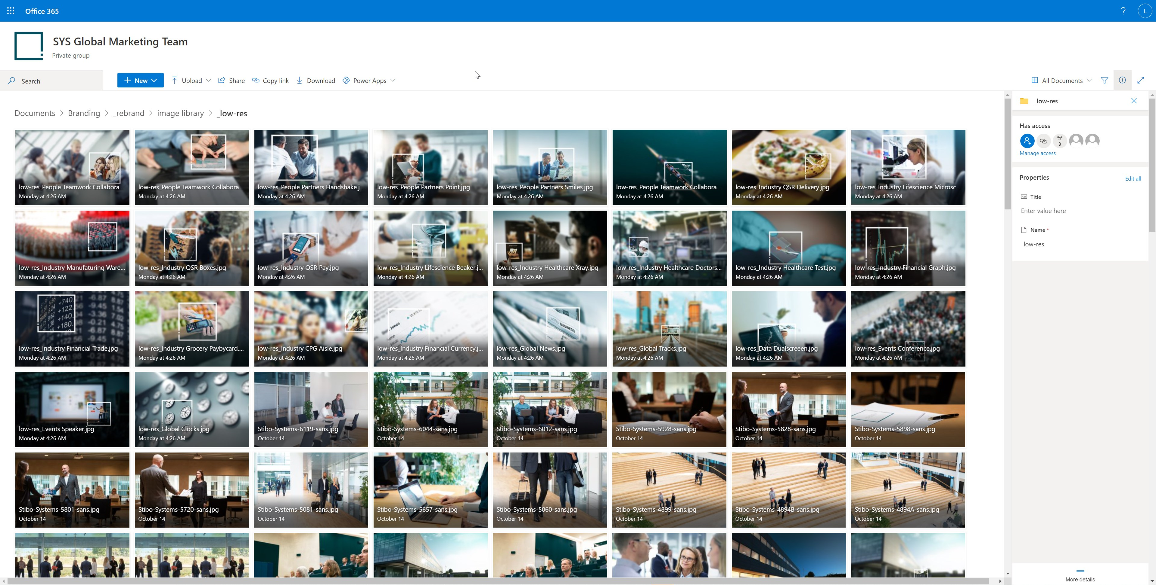
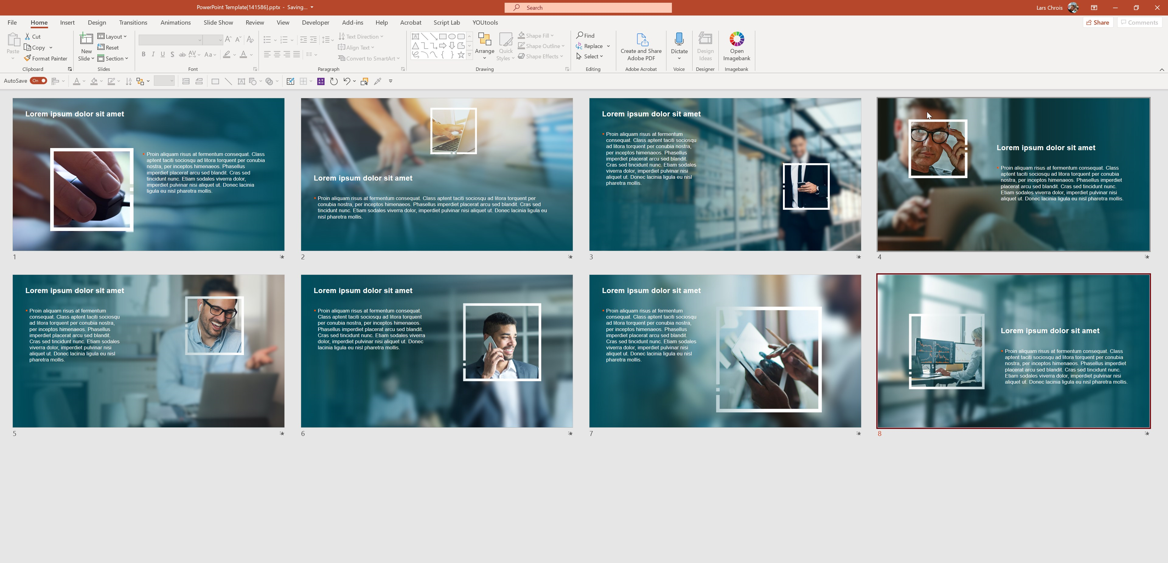
Images, icons and WoT slides
Asset library
Follow the link to access the icon library
Follow the link to access the image library
Follow the link to access the Window of Transparency slides

Slide 19
Textboxes and arrows
Toolbox
XX%
Text explaining the impressive number. We can get into some details!
A box with fill
use with less text
Detailed box
With a 14 point size we can write a lot but take care in visual presentations as this will derail your audience and they will read on instead of listening.
White box – works well for placement on a colored background
Orange border
Blue border
Background Grey

